Slide 1
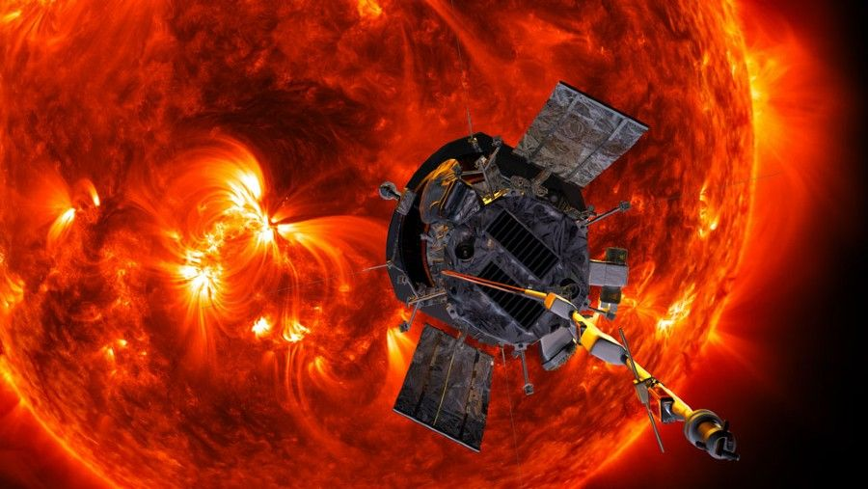
See and Hear the Data of Parker Solar Probe
by The Space Works
Kevin Holly
Louvere Walker-Hannon
Michelle Smith
Timothy Kyung
Will Campbell

Slide 2

The Challenge
Develop interactive and creative ways to improve public knowledge about the many spacecraft currently exploring the Sun, and help nonscientists interpret data from these missions using creative, user-friendly, and inviting methods

Slide 3

THE SOLUTION
Collect Parker Solar Probe sensor data from public domain
Develop an interactive, standalone application to explore magnetic data
Visualize field strength and direction
Listen to the field along different orientations
Observe daily field readings along probe’s orbital trajectory

Slide 4

THE DATA
Parker Solar Probe Gateway https://sppgway.jhuapl.edu/
Goddard Space Flight Center Coordinated Data Analysis Web https://cdaweb.gsfc.nasa.gov/pub/data/psp
Processed and consolidated 10+ gigabytes data from 1000+ CDF and ASCII text files

Slide 5
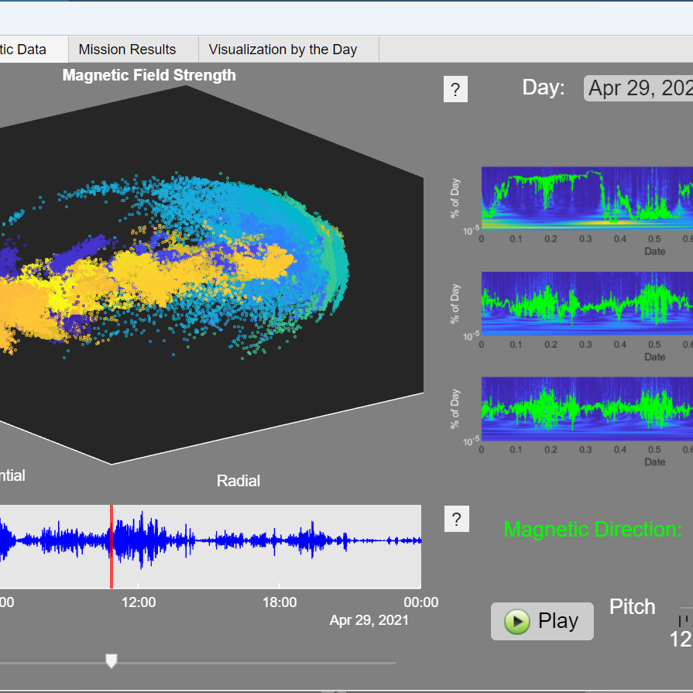
THE APP
Overview tab explains content with music generated from Solar Probe data
Magnetic field tab provides audio and visual representations for select days
Sound representation along radial, normal, and tangential axes
Scatter plot of field vector
Continuous Wavelet Transform (CWT) captures the impulsive events and reveals lower frequency features
Other visuals provided on third tab
Daily magnetic field strength along mission orbit
Daily scatter plots of field readings

Slide 6
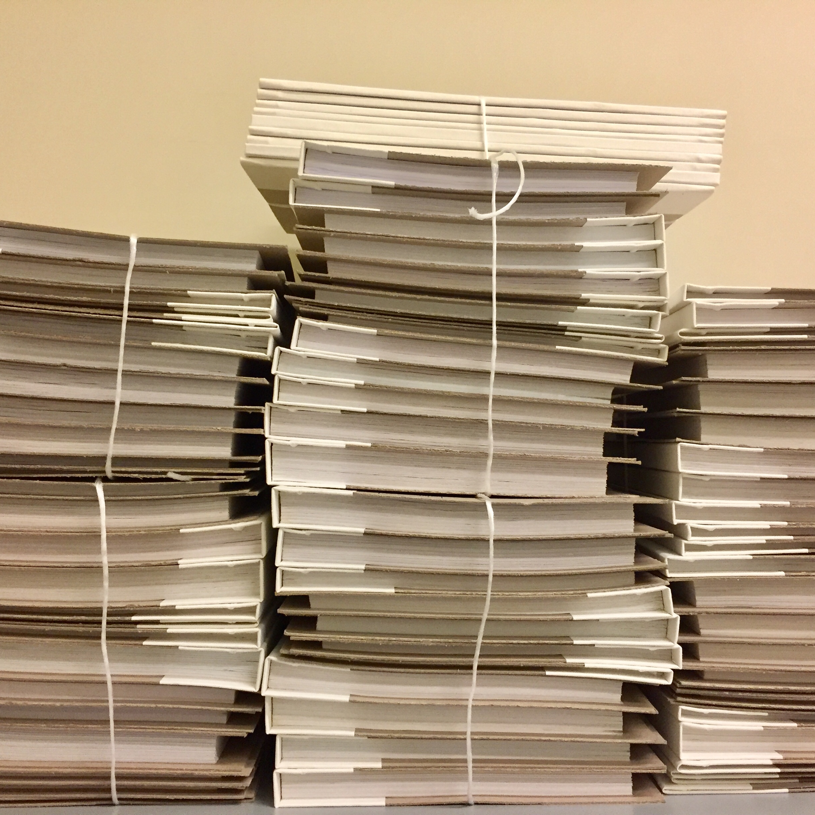
THE FILES
Solution developed in MATLAB https://github.com/recanas/NASA-Space-Apps-2022
Artifacts stored on Git

Slide 7



Thank you

